Slide 1
ECE408/CS483/CSE408 Spring 2018
Convolutional Neural Networks
Contributed by Carl Pearson
pearson@Illinois.edu

Slide 2
Objective
To learn to implement the different types of layers in a Convolutional Neural Network (CNN)

Slide 3
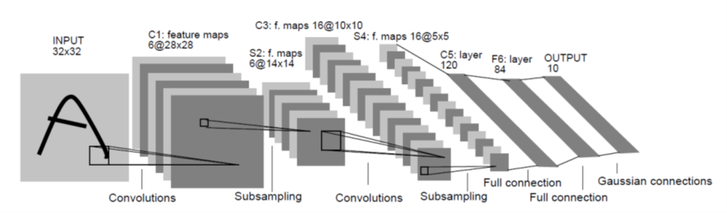
LeNet-5:CNN for hand-written digit recognition

Slide 4
Anatomy of a Convolution Layer
Input features/channels
A inputs (N₁ × N₂)
Convolution Layer
A x B convolution kernels (K₁ × K₂)
Output Features/channels
B outputs (N₁ – K₁/2) × (N₂ – K₂/2)

Slide 5
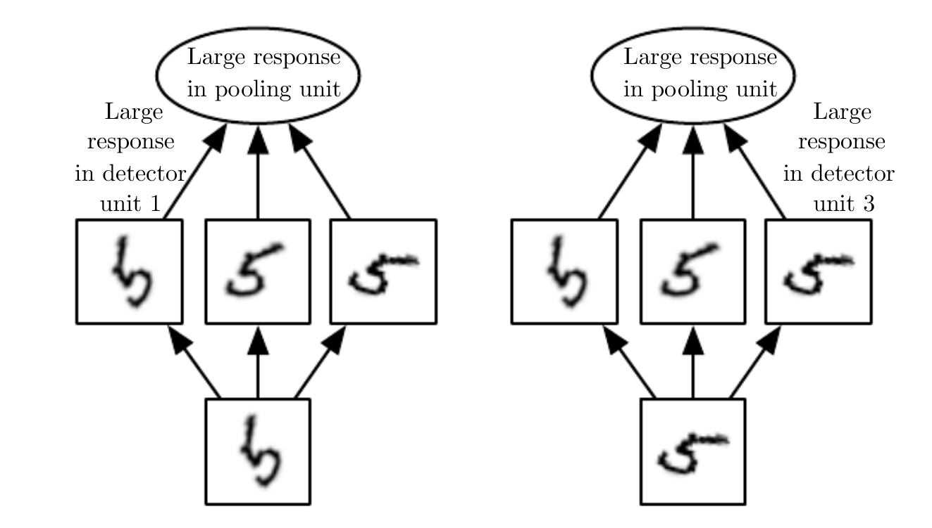
2-D Pooling (Subsampling)
A subsampling layer
Sometimes with bias and non-linearity built in
Common types: max, average, L² norm, weighted average
Helps make representation invariant to size scaling and small translations in the input

Slide 6
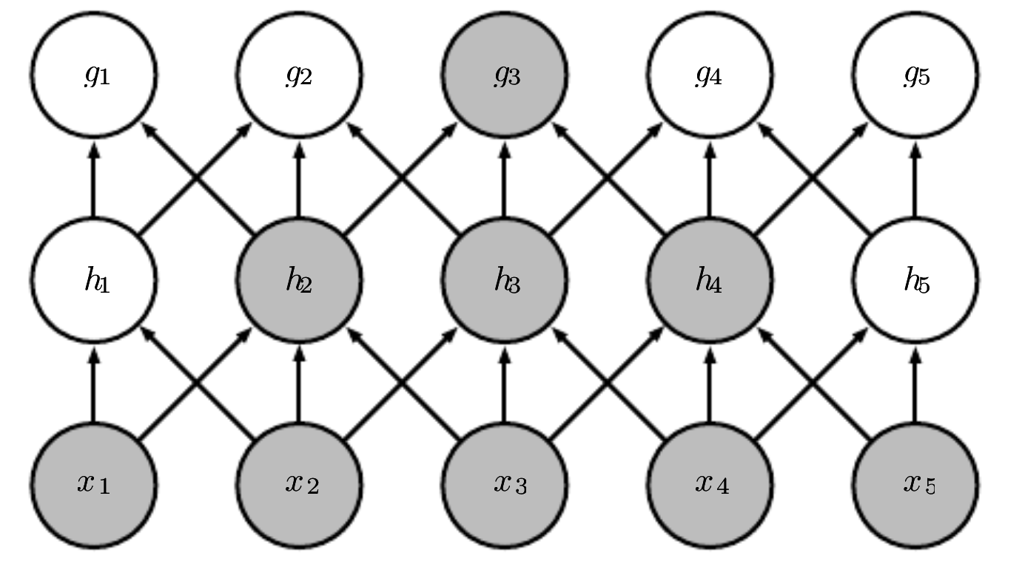
Why Convolution (1)
Sparse interactions
Meaningful features (classification) in small spatial regions
Need fewer parameters (less storage, better statistical characteristics, faster training)
Need multiple layers for wide receptive field

Slide 7
Why Convolution (2)
Parameter sharing
Kernel is reused when computing layer output
Equivariant Representations
If input is translated, output is translated the same way
Map of where features appear in input
y_{0,0}
y_{0,1}
…
y_{1,0}
+
+
w_{0,0}
w_{0,1}
w_{1,0}
x_{0,0}
x_{0,1}
…
x_{1,0}

Slide 8
Convolution
2-D Matrix
Y = W ⊗ X
Kernel smaller than input: smaller receptive field
Fewer Weights
MLP
Vector
Y = w x + b
Maximum receptive field
More weights

Slide 9
Forward Propagation

Slide 10
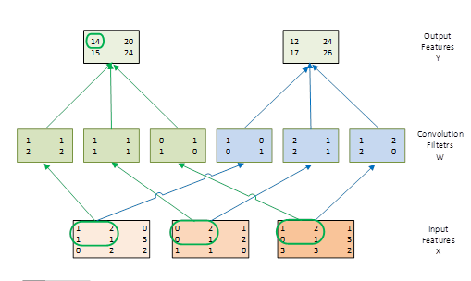
Example of the Forward Path of a Convolution Layer

Slide 11
Sequential Code: Forward Convolutional Layer
void convLayer_forward(int B, int M, int C, int H, int W, int K, float* X, float* W, float* Y) {
int H_out = H – K + 1;
int W_out = W – K + 1;
for (int b = 0; b < B; ++b) // for each image in batch
for(int m = 0; m < M; m++) // for each output feature map
for(int h = 0; h < H_out; h++) // for each output element
for(int w = 0; w < W_out; w++) {
Y[m, h, w] = 0;
for(int c = 0; c < C; c++) // sum over all input feature maps (channels)
for(int p = 0; p < K; p++) // KxK filter
for(int q = 0; q < K; q++)
Y[b, m, h, w] += X[b, c, h + p, w + q] * W[m, c, p, q];
}
}

Slide 12
Image b in mini batch
1 | 2 | 0 | 1
1 | 1 | 3 | 2
0 | 2 | 2 | 0
2 | 1 | 0 | 3
A Small Convolution Layer Example
1 | 1 | 1
2 | 2 | 3
2 | 1 | 0
X[b,0,_, _]
W[0,0,_, _]
0 | 2 | 1 | 0
0 | 3 | 2 | 1
1 | 1 | 0 | 2
2 | 1 | 0 | 3
1 | 2 | 3
1 | 1 | 0
3 | 0 | 1
0 | ?
? | ?
input channel
W[0,1,_, _]
Y[b,0,_, _]
X[b,1,_, _]
X[b, 1,_,_]
W[0,1,_, _]
0 | 1 | 1
1 | 0 | 2
1 | 2 | 1
1 | 2 | 1 | 0
0 | 1 | 3 | 2
3 | 3 | 2 | 0
1 | 3 | 2 | 0
W[0,2,_, _]
Y[0,_, _]
X[b,2,_, _]
output map

Slide 13
1 | 2 | 0 | 1
1 | 1 | 3 | 2
0 | 2 | 2 | 0
2 | 1 | 0 | 3
A Small Convolution Layer Example c = 0
1 | 1 | 1
2 | 2 | 3
2 | 1 | 0
X[b,0,_, _]
W[0,0,_, _]
3+13+2
0 | 2 | 1 | 0
0 | 3 | 2 | 1
1 | 1 | 0 | 2
2 | 1 | 0 | 3
1 | 2 | 3
1 | 1 | 0
3 | 0 | 1
18 | ?
? | ?
W[0,1,_, _]
X[b,1,_, _]
Y[b,0,_, _]
0 | 1 | 1
1 | 0 | 2
1 | 2 | 1
1 | 2 | 1 | 0
0 | 1 | 3 | 2
3 | 3 | 2 | 0
1 | 3 | 2 | 0
W[0,2,_, _]
X[b,2,_, _]

Slide 14
1 | 2 | 0 | 1
1 | 1 | 3 | 2
0 | 2 | 2 | 0
2 | 1 | 0 | 3
A Small Convolution Layer Example c = 1
1 | 1 | 1
2 | 2 | 3
2 | 1 | 0
X[b,0,_, _]
W[0,0,_, _]
… 18+
7+3+3
0 | 2 | 1 | 0
0 | 3 | 2 | 1
1 | 1 | 0 | 2
2 | 1 | 0 | 3
1 | 2 | 3
1 | 1 | 0
3 | 0 | 1
31 | ?
? | ?
W[0,1,_, _]
X[b,1,_, _]
Y[b,0,_, _]
0 | 1 | 1
1 | 0 | 2
1 | 2 | 1
1 | 2 | 1 | 0
0 | 1 | 3 | 2
3 | 3 | 2 | 0
1 | 3 | 2 | 0
W[0,2,_, _]
X[b,2,_, _]

Slide 15
1 | 2 | 0 | 1
1 | 1 | 3 | 2
0 | 2 | 2 | 0
2 | 1 | 0 | 3
A Small Convolution Layer Example c = 2
1 | 1 | 1
2 | 2 | 3
2 | 1 | 0
X[b,0,_, _]
W[0,0,_, _]
… 31+
3+6+11
0 | 2 | 1 | 0
0 | 3 | 2 | 1
1 | 1 | 0 | 2
2 | 1 | 0 | 3
1 | 2 | 3
1 | 1 | 0
3 | 0 | 1
51 | ?
? | ?
W[0,1,_, _]
X[b,1,_, _]
Y[b,0,_, _]
0 | 1 | 1
1 | 0 | 2
1 | 2 | 1
1 | 2 | 1 | 0
0 | 1 | 3 | 2
3 | 3 | 2 | 0
1 | 3 | 2 | 0
W[0,2,_, _]
X[b,2,_, _]

Slide 16
Parallelism in a Convolution Layer
All output feature maps can be calculated in parallel
Usually a small number, not sufficient to fully utilize a GPU
All output feature map pixels can be calculated in parallel
All rows can be done in parallel
All pixels in each row can be done in parallel
Large number but diminishes as we go into deeper layers
All input feature maps can be processed in parallel, but will need atomic operation or tree reduction

Slide 17
Design of a Basic Kernel
Each block computes a tile of output pixels
TILE_WIDTH pixels in each dimension
The x dimension in the grid maps to the M output feature maps
The y dimension in the grid maps to the tiles in the output feature maps (linearization)

Slide 18
CUDA Grid and Threadblocks
A Small Example
Assume 4 output feature maps (M = 4)
Each output feature map is 8x8 image (W_out = H_out = 8)
We have 4 blocks in the x dimension
If we use tiles of 4 pixels on each side (TILE_SIZE = 4)
We have 4 blocks in the x dimension
Top two blocks in each column calculates the top row of tiles in the corresponding output feature map
Bottom two block in each column calculates the bottom row of tiles in the corresponding output feature map
Output Feature Maps and Tiles

Slide 19
Host Code for a Basic Kernel: CUDA Grid
W_out and H_out are the output feature map width and height
# define TILE_WIDTH 16 // We will use 4 for small examples.
W_grid = W_out/TILE_WIDTH; // number of horizontal tiles per output map
H_grid = H_out/TILE_WIDTH; // number of vertical tiles per output map
Y = H_grid * W_grid;
dim3 blockDim(TILE_WIDTH, TILE_WIDTH, 1);
dim3 gridDim(M, Y, 1);
ConvLayerForward_Kernel<<< gridDim, blockDim>>>(…);

Slide 20
A Basic Conv. Layer Forward Kernel (Code is Incomplete!)
__global__ void ConvLayerForward_Basic_Kernel(int C, int W_grid, int K,
float* X, float* W, float* Y)
{
int m = blockIdx.x;
int h = blockIdx.y / W_grid + threadIdx.y;
int w = blockIdx.y % W_grid + threadIdx.x;
float acc = 0.;
for (int c = 0; c < C; c++) { // sum over all input channels
for (int p = 0; p < K; p++) // loop over KxK filter
for (int q = 0; q < K; q++)
acc += X[c, h + p, w + q] * W[m, c, p, q];
}
Y[m, h, w] = acc;
}

Slide 21
Some Observations
The amount of parallelism is quite high as long as the total number of pixels across all output feature maps is large
This matches the CNN architecture well
Each input tile is loaded multiple times, once for each block that calculates the output tile that requires the input tile
Not very efficient in global memory bandwidth

Slide 22
Sequential Code: Forward Pooling Layer
void poolingLayer_forward(int B, int M, int H, int W, int K, float* Y, float* S) {
for (int b = 0; b < B; ++b) // for each image in the batch
for (int m = 0; m < M; ++m) // for each output feature map
for (int h = 0; h < H/K; ++h) // for each output element
for (int w = 0; w < W/K; ++y) {
S[m, h, w] = 0.;
for (int p = 0; p < K; ++p) // loop over KxK input samples
for (int q = 0; q < K; ++q)
S[b, m, h, w] += Y[b, m, K*h + p, K*w + q] /(K*K);
}
S[b, m, h, w] = sigmoid(S[b, m, h, w] + b[m]) // bias, non-linearity
}

Slide 23
Kernel Implementation of Subsampling Layers
Straight forward mapping from grid to subsampled output feature map pixels
Need to manipulate index mapping for accessing the output feature map pixels of the previous convolution layer
It is often merged into the previous convolution layer to save memory bandiwdth

Slide 24
Optimizing Convolution Layers

Slide 25
Implementing a Convolution Layer with Matrix Multiplication

Slide 26
Simple Matrix Multiplication
1 | 2 | 1 | 1
2 | 0 | 1 | 3
1 | 1 | 0 | 2
1 | 3 | 2 | 2
0 | 2 | 0 | 3
2 | 1 | 3 | 2
0 | 3 | 1 | 1
3 | 2 | 1 | 0
1 | 2 | 1 | 1
2 | 1 | 0 | 3
0 | 1 | 3 | 3
1 | 3 | 3 | 2
0
Each product matrix element is an output feature map pixel.
This inner product generates element 0 of output feature map 0.
Input feature maps
1
2
Convolution Filters
0
1 | 1 | 2 | 2 | 1 | 1 | 1 | 1 | 0 | 1 | 1 | 0
1 | 0 | 0 | 1 | 2 | 1 | 2 | 1 | 1 | 2 | 2 | 0
14 | 20 | 15 | 24
12 | 24 | 17 | 26

Slide 27
Tiled Matrix Multiplication
2x2 Example
1 | 2 | 1 | 1
2 | 0 | 1 | 3
1 | 1 | 0 | 2
1 | 3 | 2 | 2
0 | 2 | 0 | 3
2 | 1 | 3 | 2
0 | 3 | 1 | 1
3 | 2 | 1 | 0
1 | 2 | 1 | 1
2 | 1 | 0 | 3
0 | 1 | 3 | 3
1 | 3 | 3 | 2
0
Each block calculates one output tile – 2 elements from each output map
Each input element is reused 2 times in the shared memory
Input feature maps
1
2
Convolution Filters
0
1 | 1 | 2 | 2 | 1 | 1 | 1 | 1 | 0 | 1 | 1 | 0
1 | 0 | 0 | 1 | 2 | 1 | 2 | 1 | 1 | 2 | 2 | 0
14 | 20 | 15 | 24
12 | 24 | 17 | 26
1

Slide 28
Tiled Matrix Multiplication 2x4 Example
1 | 2 | 1 | 1
2 | 0 | 1 | 3
1 | 1 | 0 | 2
1 | 3 | 2 | 2
0 | 2 | 0 | 3
2 | 1 | 3 | 2
0 | 3 | 1 | 1
3 | 2 | 1 | 0
1 | 2 | 1 | 1
2 | 1 | 0 | 3
0 | 1 | 3 | 3
1 | 3 | 3 | 2
0
Each block calculates one output tile – 4 elements from each output map
Each input element is reused 2 times in the shared memory
Input feature maps
1
2
Convolution Filters
0
1 | 1 | 2 | 2 | 1 | 1 | 1 | 1 | 0 | 1 | 1 | 0
1 | 0 | 0 | 1 | 2 | 1 | 2 | 1 | 1 | 2 | 2 | 0
14 | 20 | 15 | 24
12 | 24 | 17 | 26
1

Slide 29
Efficiency Analysis: Total Input Replication
Replicated input features are shared among output maps
There are H_out * W_out output feature map elements
Each requires K*K elements from the input feature maps
So, the total number of input element after replication is H_out*W_out*K*K times for each input feature map
The total number of elements in each original input feature map is (H_out+K-1) * (W*out+K-1)

Slide 30
Analysis of a Small Example
H_out = 2
W_out = 2
K = 2
There are 3 input maps (channels)
The total number of input elements in the replicated (“unrolled”) input matrix is 3*2*2*2*2
The replicating factor is
(3*2*2*2*2)/(3*3*3) = 1.78

Slide 31
Memory Access Efficiency of Original Convolution Algorithm
Assume that we use tiled 2D convolution
For input elements
Each output tile has TILE_WIDTH² elements
Each input tile has (TILE_WIDTH+K-1)²
The total number of input feature map element accesses was TILE_WIDTH²*K²
The reduction factor of the tiled algorithm is K²*TILE_WIDTH²/(TILE_WIDTH-K+1)²
The convolution filter weight elements are reused within each output tile

Slide 32
Properties of the Unrolled Matrix
Each unrolled column correspond to an output feature map element
For an output feature element (h,w), the index for the unrolled column is h*W_out+w (linearized index of the output feature map element)

Slide 33
Properties of the Unrolled Matrix
(cont.)
Each section of the unrolled column correspond to an input feature map
Each section of the unrolled column has k*k elements (convolution mask size)
For an input feature map c, the vertical index of its section in the unrolled column is c*k*k(linearized index of the output feature map element)

Slide 34
To Find the Input Elements
For output element (h,w), the base index for the upper left corner of the input feature map c is (c, h, w)
The input element index for multiplication with the convolution mask element (p, q) is (c, h+p, w+q)

Slide 35
Input to Unrolled Matrix Mapping
Output element (h, w)
Mask element (p, q)
Input feature map c
// calculate the horizontal matrix index
int w_unroll = h * W_out + w;
// find the beginning of the unrolled
int w_base = c * (K*K);
// calculate the vertical matrix index
int h_unroll = w_base + p * K + q;
X_unroll[b, h_unroll, w_unroll] = X[b, c, h + p, w + q];

Slide 36
Function to generate “unrolled” X
void unroll(int B, int C, int H, int W, int K, float *X, float *X_unroll) {
int H_out = H – K + 1;
int W_out = W – K + 1;
for (int b = 0; b < B; ++b) //for each image in the batch
for (int c = 0; c < C; ++c) { // for each input channel
int w_base = c * (K*K); { // find the beginning of the unrolled section in column
for (int p = 0; p < K; ++p)
for (int q = 0; q < K; ++q) { // loop over all positions of convolution mask
for (int h = 0; h < H_out; ++h)
for (int w = 0; w < W_out; ++w) { // for each output feature map element
int h_unroll = w_base + p * K + q; // calculate the vertical matrix index
int w_unroll = h * W_out + w; // calculate the horizontal matrix index
X_unroll[b, h_unroll, w_unroll] = X[b, c, h + p, w + q];
}
}
}

Slide 37
Implementation Strategies for a Convolution Layer
Baseline
Tiled 2D convolution implementation, use constant memory for convolution masks
Matrix-Multiplication Baseline
Input feature map unrolling kernel, constant memory for convolution masks as an optimization
Tiled matrix multiplication kernel
Matrix-Multiplication with built-in unrolling
Perform unrolling only when loading a tile for matrix multiplication
The unrolled matrix is only conceptual
When loading a tile element of the conceptual unrolled matrix into the shared memory, use the properties in the lecture to load from the input feature map
More advanced Matrix-Multiplication
Use joint register-shared memory tiling

Slide 38
Enjoy the project!

